Slide 1
Working with Parameters
Elaborated by: Douglas Garcia
douglas@ideliver-inc.com

Slide 2
Agenda
Parameters
Input Parameters
Output Parameters
Local Parameters
Parameter Linkage
Type of Parameters
Create parameters
Define type of parameters
Parameter Promotion
Demo
Exercise

Slide 3
Parameters
They can affect the behavior and results of a business process.
Parameters are used to define values that the components are going to receive and return
BPT components
Notes:
You can affect the behavior and results of a business process test by using parameters to define the values that components and flows receive and return. This process is known as

Slide 4
Parameterization
They enable you to perform operations on the application you are testing with multiple sets of data.
Notes:
Parameterization enables you to perform operations on the application you are testing with multiple sets of data.

Slide 5
Input Parameters
Data used by a component or flow
The data is provided from an external source.
Int
String
BPT Process
Notes:
When creating components, tests, and flows, you define how the values are supplied for input parameters.
An input parameter can receive:
A predefined default value, if no other value is supplied by the test or flow.
An output parameter value returned by a component or flow earlier in the test.
An output parameter value from a component earlier in the same flow.
A parameter value that is supplied at the test level, or when the flow runs in a business process test.

Slide 6
Output Parameters
Data that is retrieved and stored by a component
They can be used in subsequent components or flows
Data
Flow 1
component
component
Flow 2
Notes:
Output parameters allow data values retrieved from a component step or flow (the source) to be passed as input parameters to a subsequent component or flow (the target) in the test run.
You define component output parameter names and descriptions for the business component in

Slide 7
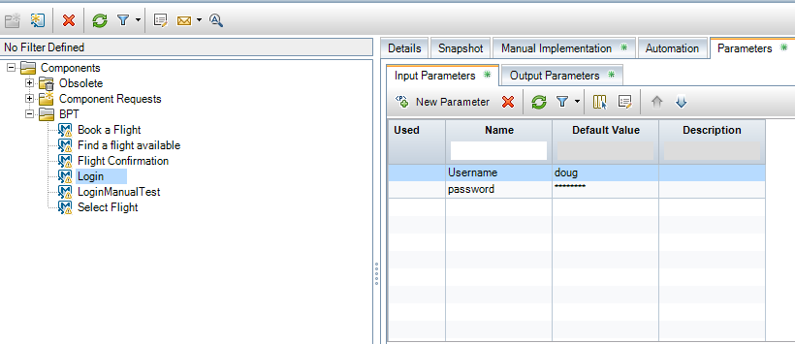
Add Input/Output Parameters
Business Component
Module
1
1. Create a new
component
2. Go to parameters tab
3. Go to Input/output
Parameters tab
4. Click “New parameter”
2
3
3
4

Slide 8
Local Parameters
They are specific to the business component
They can be accessed by that component only
they are supposed to use in a single step or between components.
value1
value2
Notes:
A local parameter is specific to the business component. Its value is defined within the component and can be accessed by that component only. It is intended for use in a single step or between component steps

Slide 9
Type of Parameters
Data
Flow 1
component
component
Flow 2

Slide 10
Default Values
Defined when you create or edit a component.
Only used for input parameters
Integer Value
String Value
Date value
Notes:
You set default values when creating and editing variables in the Business Components and Test Plan modules. Only input parameters can have default values.

Slide 11
Actual Values
Specified when working with iterations and test configurations.
Also specify when running a BPT test
Running a BPT test
Value 1
Value 2
Value 3
Notes:
You can specify actual values in the Test Plan module when working with iterations and test configurations. You can also specify actual values when running a business process test or flow in the Test Lab module.

Slide 12
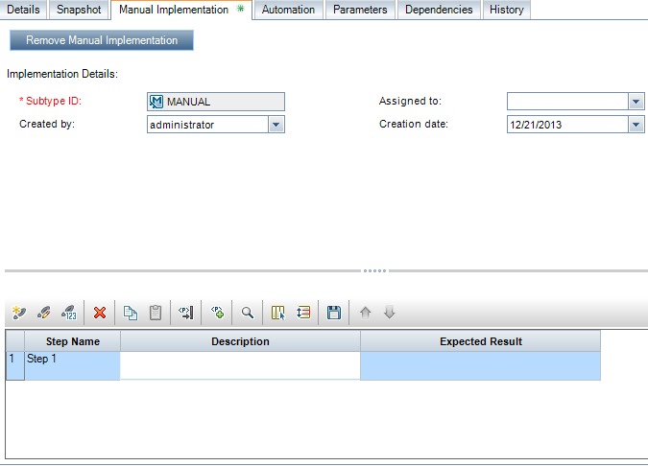
Creating Parameters While Defining Manual Steps
Click “Add” or “modify” an existing steps to add a parameters

Slide 13
Type of Parameters
Data
Flow 1
component
component
Flow 2

Slide 14
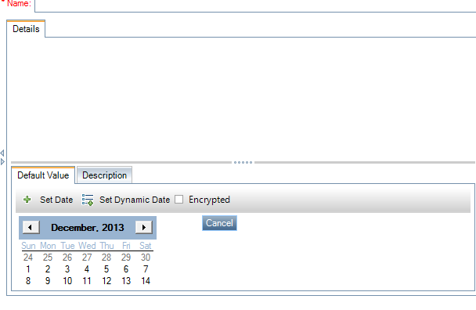
Creating Types of Parameters
How to set Date Value?
Click “Set Date”

Slide 15
Creating Types of Parameters
How to set dynamic Date Value?
Click “Set Dynamic Date”
Notes:
A dynamic date is a date relative to the current date (today, yesterday, a year from today). You can add or subtract an offset time period to the relative date that you specify (such as 3 months before one year ago).

Slide 16
Creating Types of Parameters
How to encrypt a value?
Click “Encrypted check box”

Slide 17
Parameter Promotion
Promoting enables to components and flows access parameters
Create Loan
LoanID
Search Loan
LoanID
Aprove Loan
LoanID
Business Process
Notes:
Promoting parameters enables the components in other flows (and components and flows in other tests) to access a parameter value.
You can promote component parameters to the flow or test level at the same time as you add a component to a flow or test

Slide 18
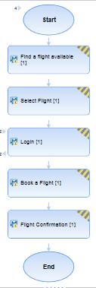
Parameter Promotion example

Slide 19
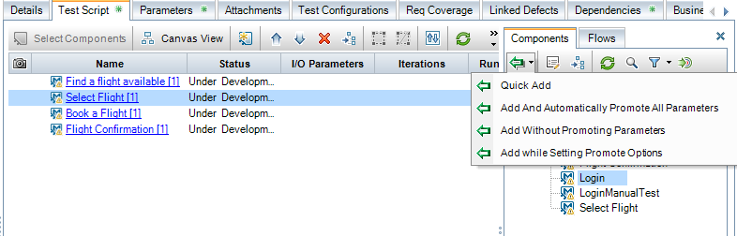
How to Promote Parameters
Go to test plan module
Click “Select Components”

Slide 20
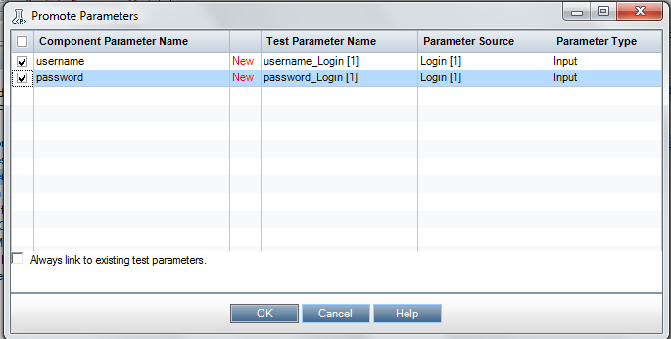
How to Promote Parameters(cont.)
Options:
Promote the parameters automatically
Adding the component while setting promote option
Add without promoting parameters

Slide 21

Demo

Slide 22

Exercise

